Slide 1
Hard Mode 101

Slide 2
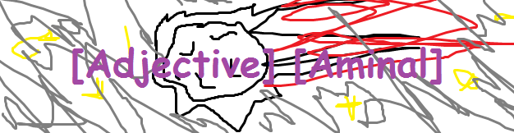
Meet the Team
Tracy Lee :: 3rd yr CogSci
Mina Li :: 3rd yr CS
Calvin Lu :: 3rd yr CS/Psych
Austin Shyu :: 2nd year EECS

Slide 3
Meet the Team
Tracy Lee :: Any/All Pronouns
Mina Li :: They/Them, Ze/Hir
Calvin Lu :: He/Him
Austin Shyu :: He/Him

Slide 4
Synopsis
Our game is a slice-of-life visual novel with the player experiencing daily struggles through the lens of a queer student. As you navigate through the challenges in life and school, you'll find yourself in battle with metaphorical monsters and fight with challenge-specific attacks to overcome the obstacle in your day.
Plan your attacks wisely to maximize your happiness and well-being, but don't forget about your grades, too!

Slide 5
Basic Concepts
A slice-of-life novel with RPG elements.
Metaphorical battles act as a way to imitate the kind of stress and anxiety associated with handling the challenge of school and life. We represent each challenge with a different monster, and your attacks echo real-life responses to these obstacles.
We wanted to the user to play from a first person POV so that the game doesn’t force upon you a certain image of what the protagonist is like.

Slide 6
Creative Goals
Make a game that is relatable to queer-identified students, touching upon difficult situations, such as social anxiety and taking exams.
We wanted it to be light-hearted and cute with the metaphors and artwork, while still addressing something that is relevant in our lives.
The metaphor of a battle relates to the struggle of handling these issues. The statistics that affect your battle represent how we, as students, have to make choices regarding sacrificing grades and happiness levels.

Slide 7
Challenges
Pairing Unity with GitHub.
User Interface: Trying to make it intuitive for gamers and non-gamers.
Time management and scheduling.
Scope.

Slide 8
Future Plans
If we have time, we'd like to clean up some of the little details so that we feel completely satisfied with it.
We want this to be a polished product we'd be proud to show our friends and family (and put on our resumes).

Slide 9
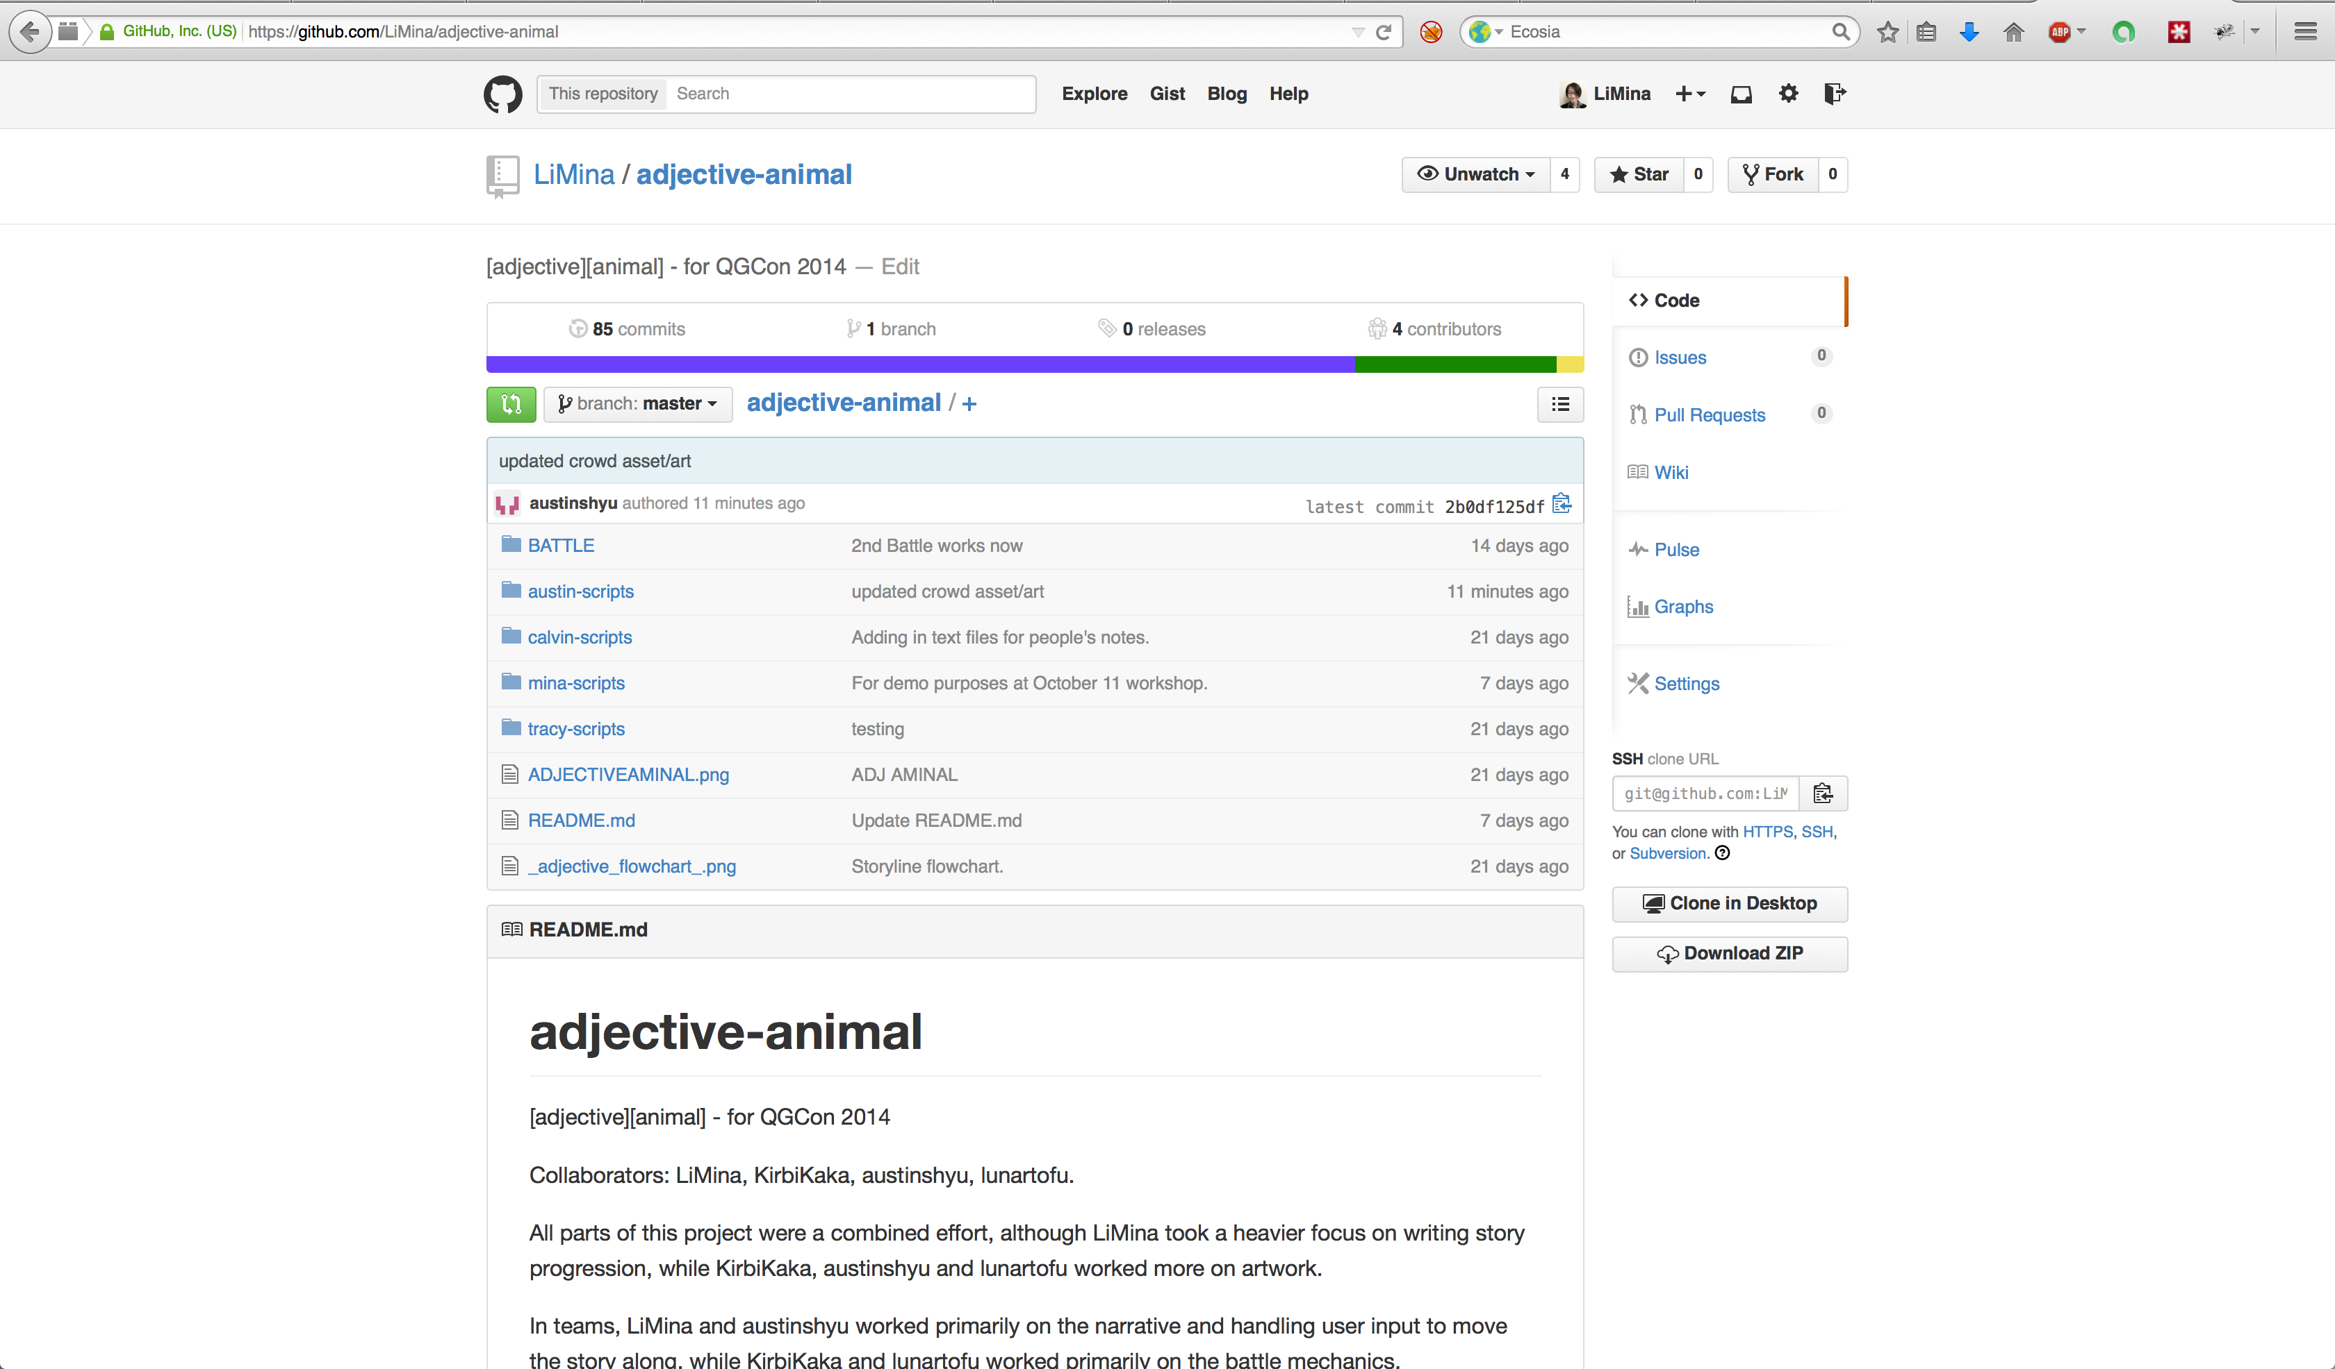
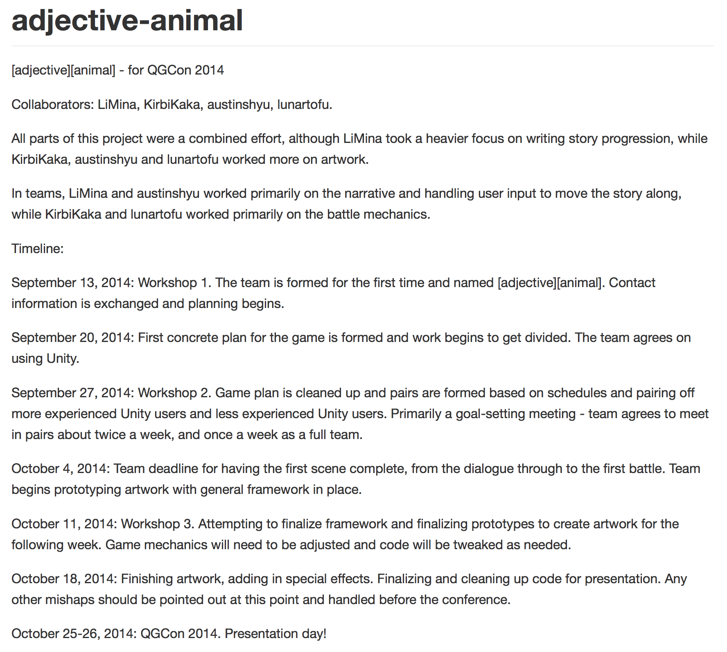
Screenshots

Slide 10
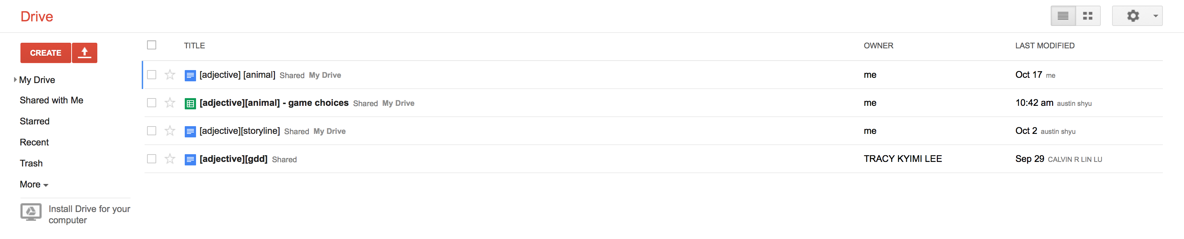
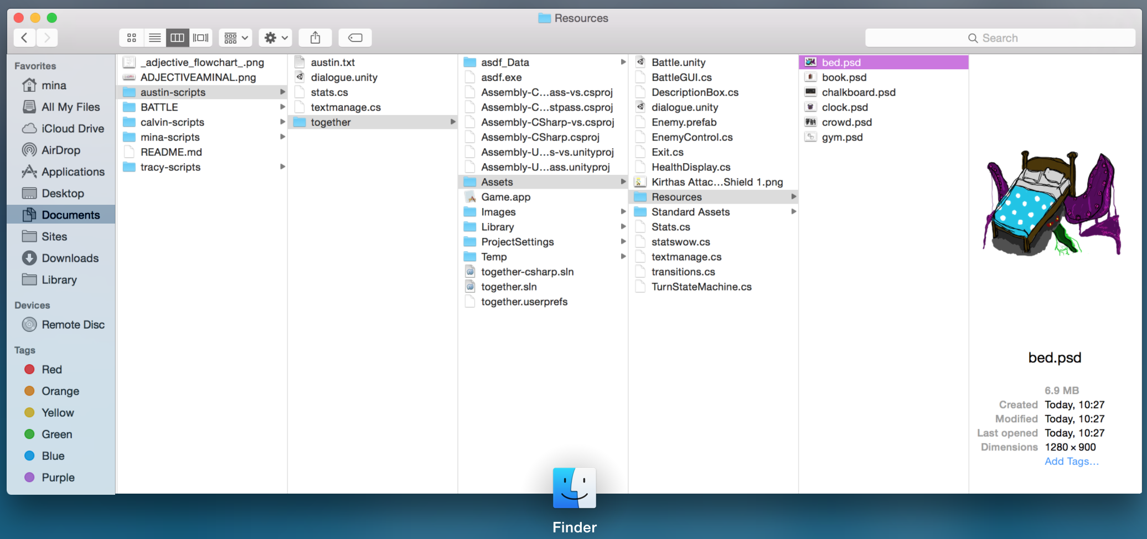
Screenshots

Slide 11
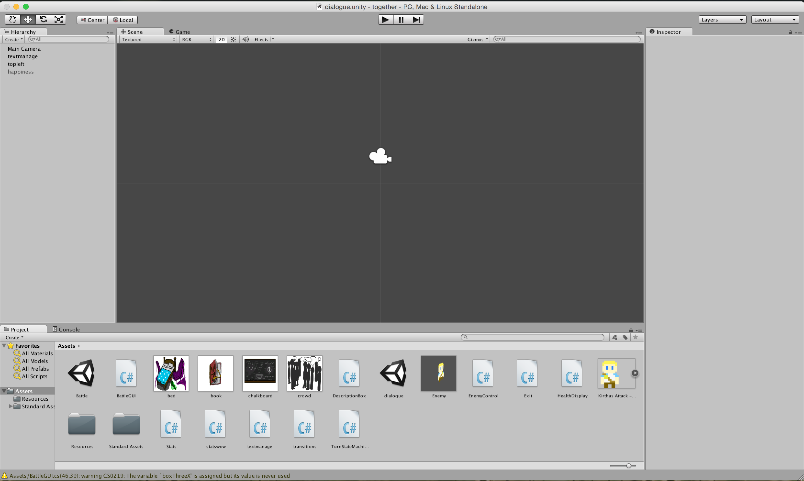
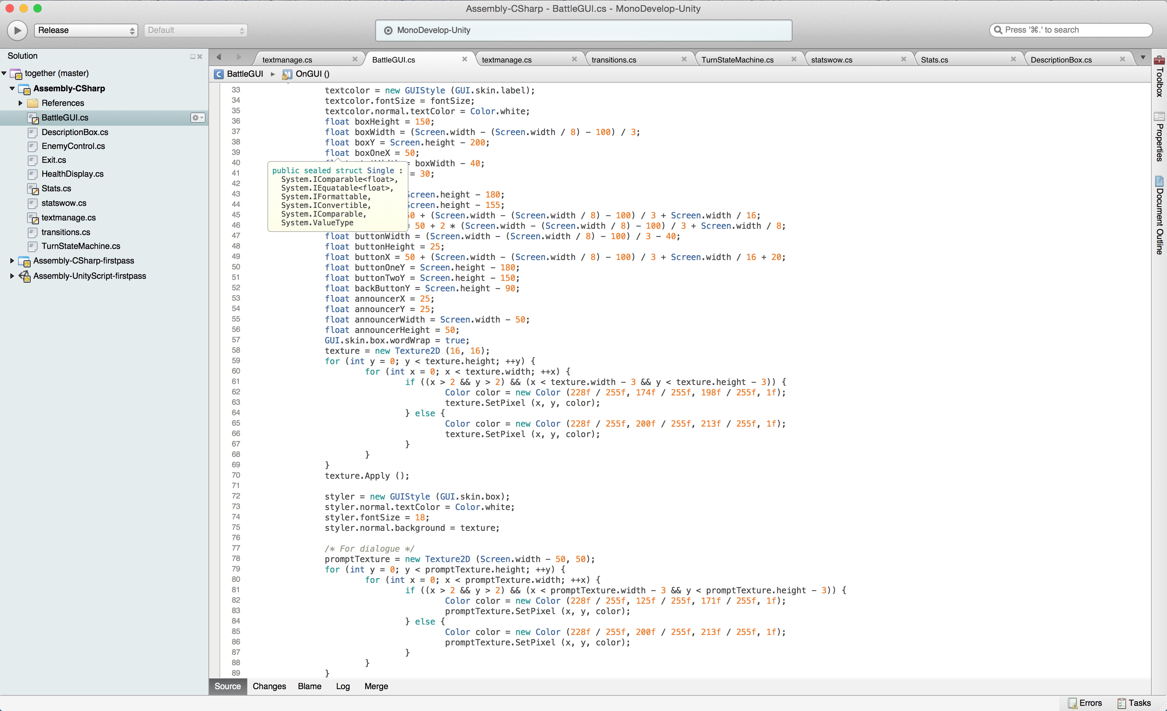
Screenshots

Slide 12
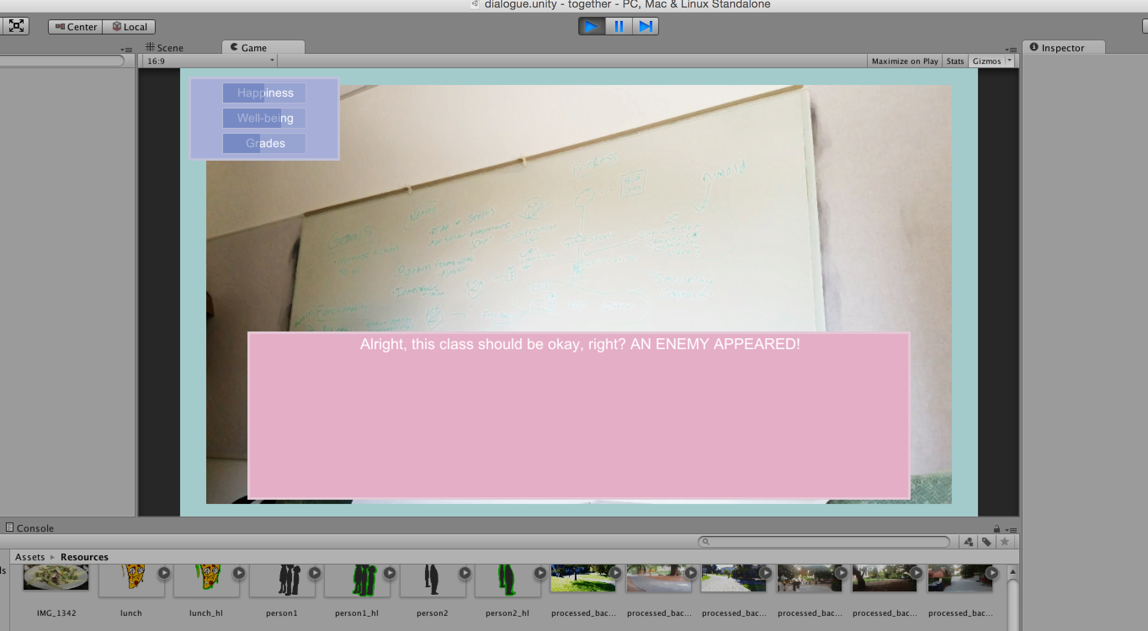
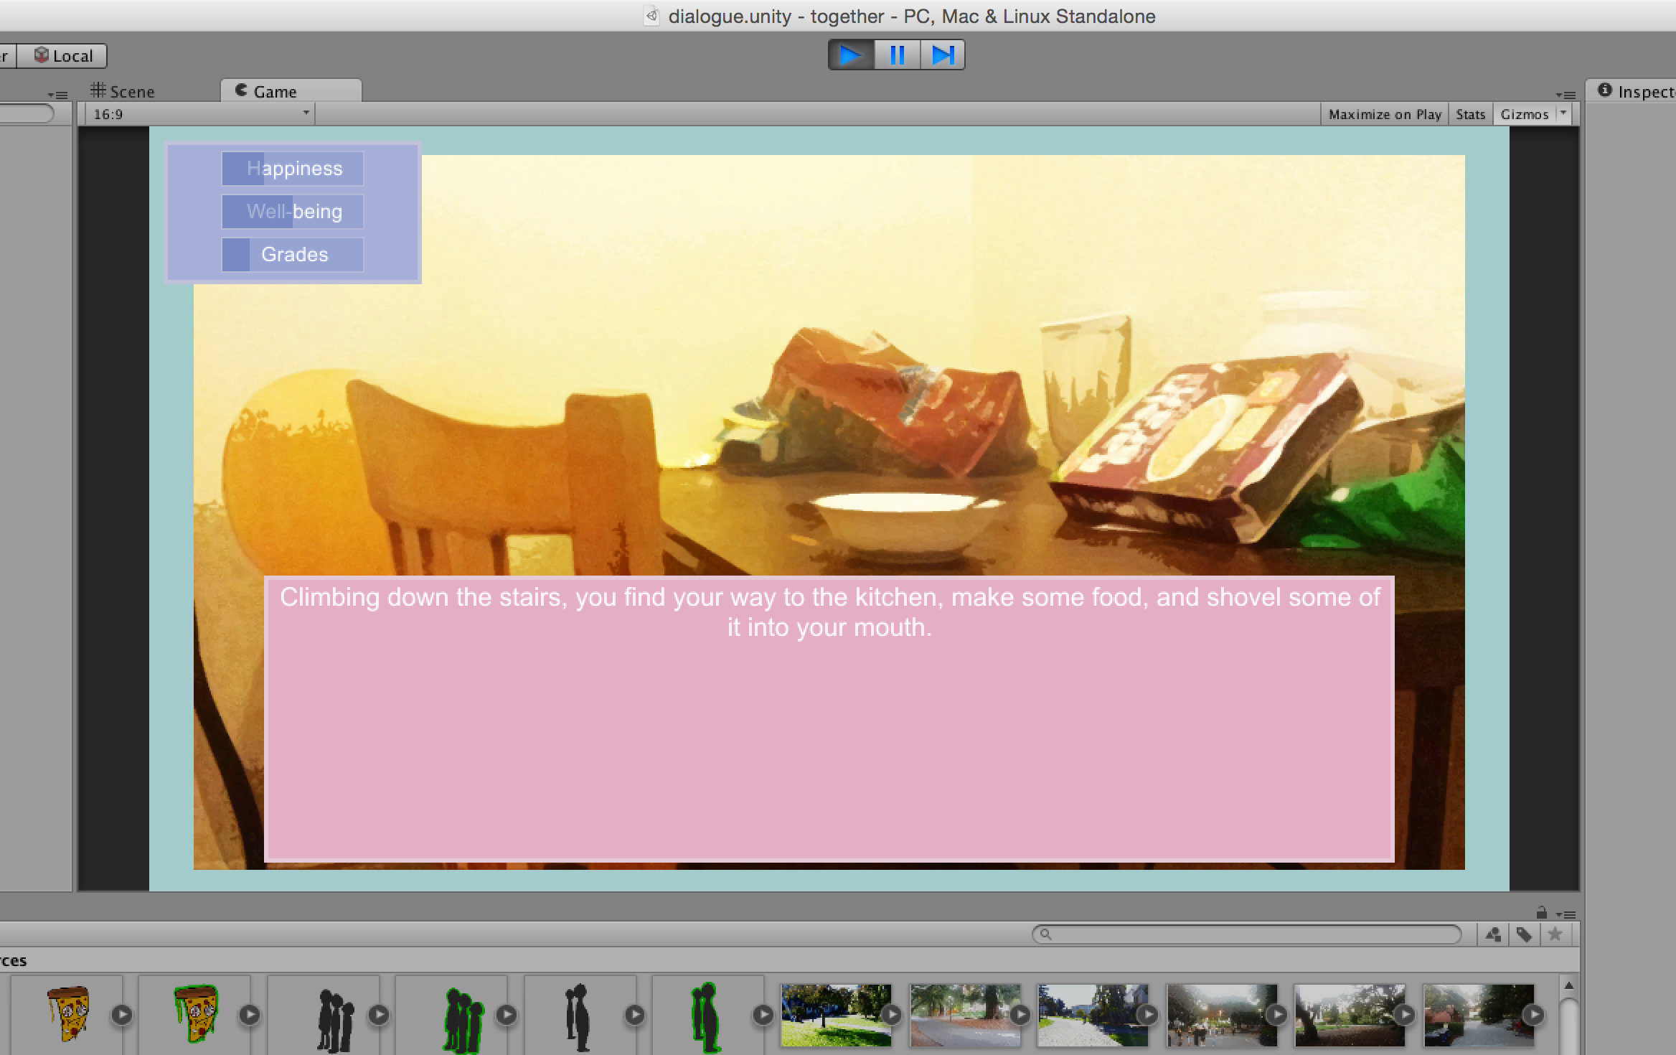
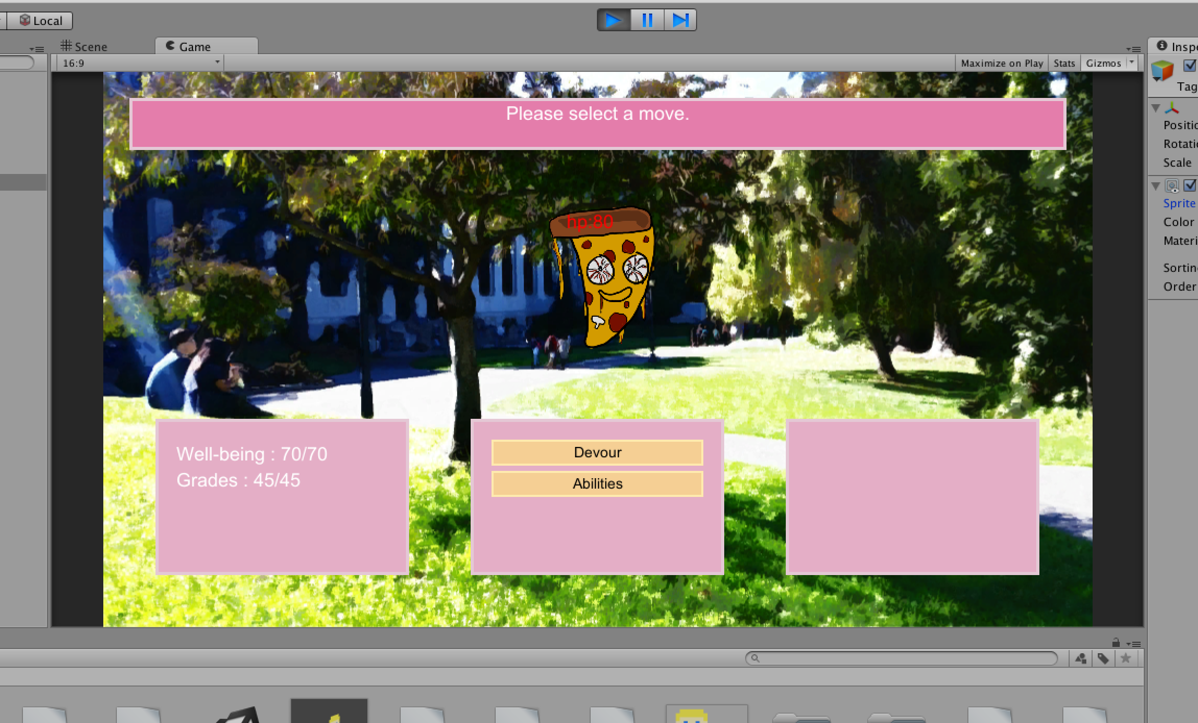
Screenshots

Slide 13
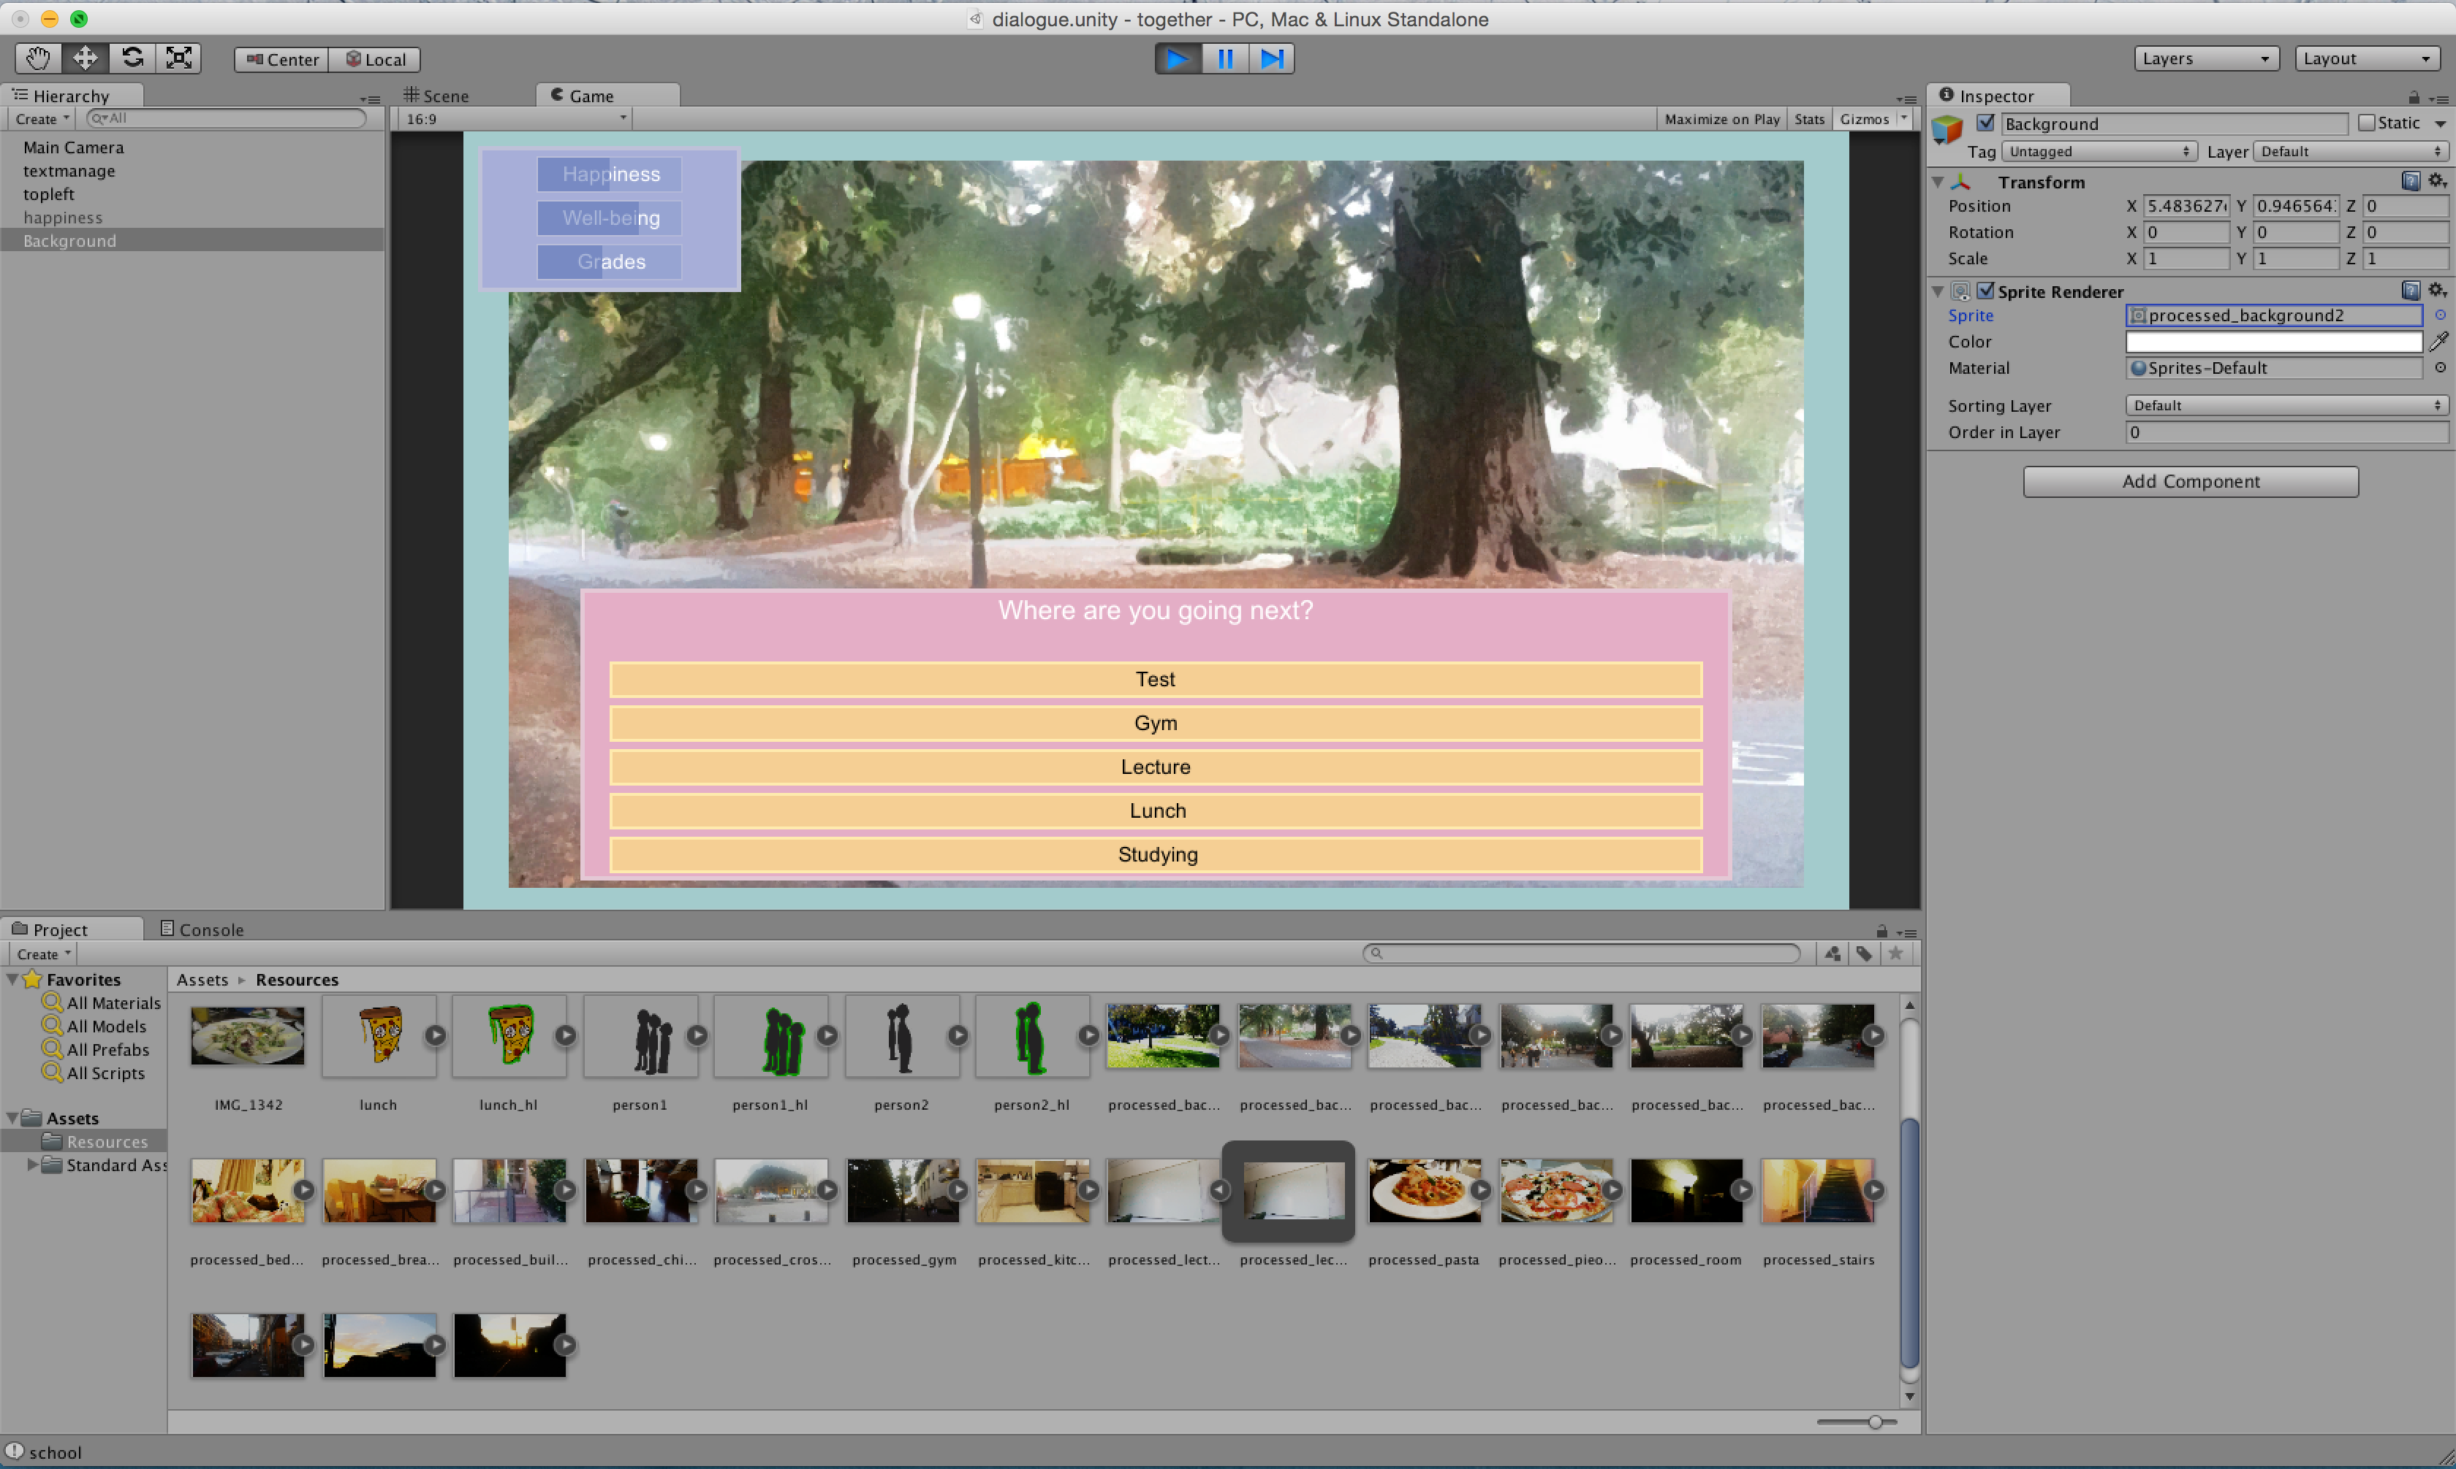
Screenshots

Slide 14
Download
https://github.com/LiMina/adjective-animal

